Slide 1
Computational Techniques on Spatial Big Data

Slide 2
Outline
Spatial Big Data Computation
Examples of Spatial Big Data Processing Systems
Conclusion

Slide 3



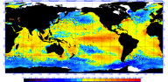
1.1 What is Spatial Big Data (SBD)?
Geo-referenced data whose volume, velocity or variety exceeds the capability of conventional spatial computing techniques
Beijing Taxi GPS trajectories
(http://www.microsoft.com)
Check-in Records
(http://www.google.com)
Earth imagery
(http://ozewex.org/)
Spatial events: highway serial killing
(http://fbi.gov/)
Climate model simulation
(http://noaa.gov/)

Slide 4

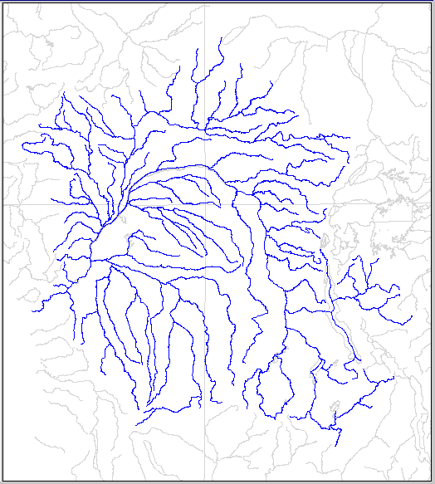
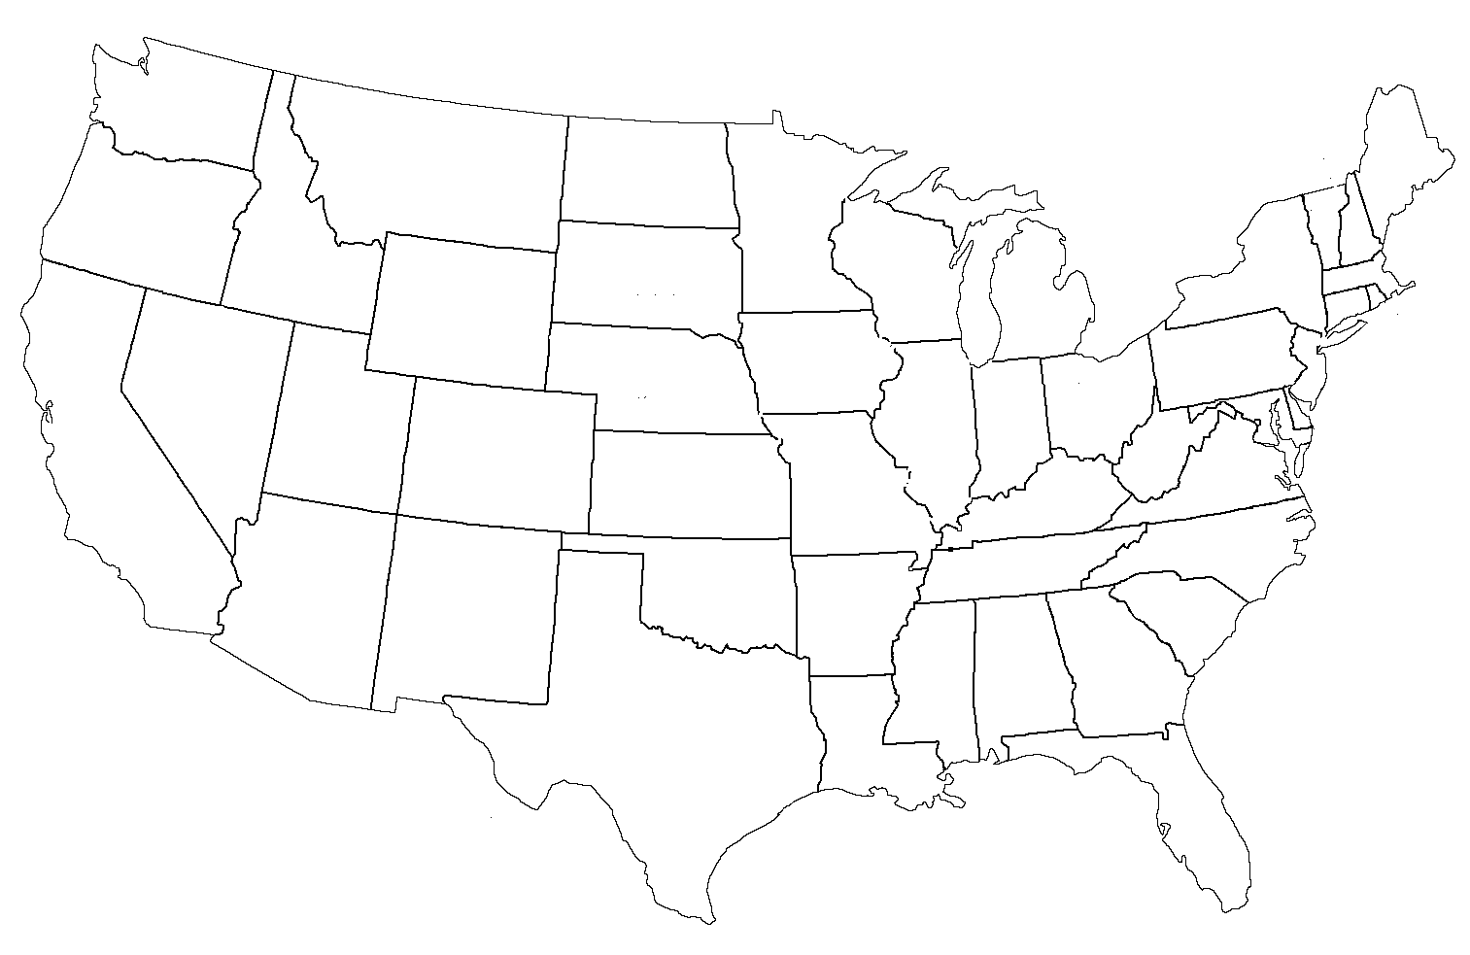
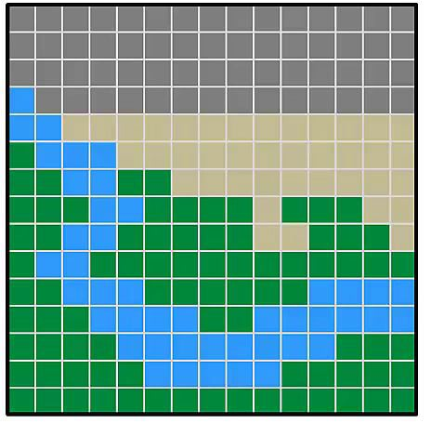
1.2 Spatial Data Types
Object Model
Field Model
Points (Cities in Alabama)
(http://www.123rf.com)
Lines(Congo river network in Africa) (http://www.ce.utexas.edu/)
Polygons (States in USA)
(www.statesymbolsusa.org)
Raster Data (Land and River Representation in Raster)
(https://vimeo.com)

Slide 5
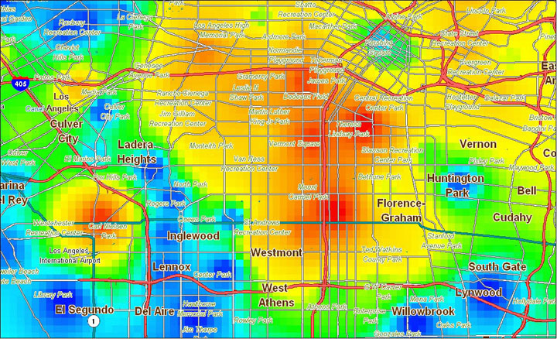
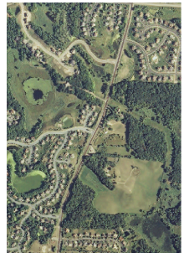
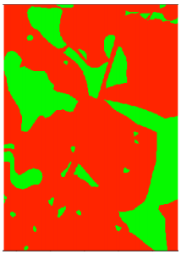
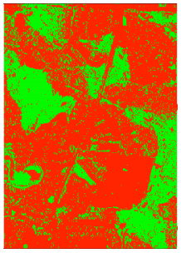
1.3 Spatial Computational Problem
Spatial Query
Set query
Topological space query
Metric space query
Spatial Data Analytics
Hotspot Detection
Spatial Prediction
C
A
B
A
B
Find Intersection
Find Union
Auto-Theft Hotspot in Los Angeles (Source: https://hexagongeospatial.fluidtopics.net)
A
A
B
B
Touch
Contain/Within
A
Aerial photo Chanhassen, MN
Ground Truth Wetland Map
Decision Tree Prediction
Distance
Angle
Wetland Prediction
(Source: http://ieeexplore.ieee.org/document/6963450/)

Slide 6
1.4 Conventional Spatial Computing Solutions
R-Tree
R10 | R11
R10
Spatial Query:
Spatial Database
Spatial data types
Multi-dimensional indexing
Spatial query processing
Spatial Data Analytics:
Spatial Data Mining
Hotspot Detection: Spatial scan statistics
Spatial Prediction: Spatial decision tree
R7
0
R1
X
X
R7 | R8
R9
R2
X
X
X
X
R1 | R2
R3 | R4
R5 | R6
Examples
R11
R8
R5
R9
R4
R3
R6
Multi-dimensional Indexing
R10
R1
Which object is within the red box?
Open Research
R2
Result
R11
R5
R5
How to scale to SBD?
R4
R3
R6
Filter and Refine Strategy

Slide 7
Outline
Spatial Big Data Computation
Examples of Spatial Big Data Processing Systems
Conclusion

Slide 8
Example 1: Google Earth Engine
Cloud-based spatial big data systems
Petabytes of earth imagery
Data analytics (mining) and visualization

Slide 9
Google Earth Engine
Petabyte data archive (over 40 years)
Landsat
MODIS
Sentinel-1
Sentinel-2
Computation
Front-end scripts
Javascript, Python
Visualization
Back-end computation
Cloud with many CPU
Lazy computation

Slide 10
Google Earth Engine
Spatial Operations Supported (API)
Loading or selection spatial data
Raster imagery
Vector data (shapefile)
Basic spatial operations
Spatial join for vector objects
Spatial raster operations (local, focal, zonal)
Advanced spatial analysis
Supervised algorithms (e.g., decision tree)
Image classification
A Demo

Slide 11
Example 2: Hadoop-GIS and Spatial Hadoop
Built based on Hadoop.
Spatial Data Type support: Point, Line and Polygon
Distributed multi-dimensional indexing
Spatial query processing

Slide 12
Background on MapReduce
<Intermediate Key,
Reduced Value>
<Key, Value>
<Intermediate Key, new Value>
<doc id, all words>
<word, countsInDoc>
<word, countsTotal>
<“spatial”, 1>
<“big”, 1>
<“data”,1>
<”course”,1>
<1, “spatial big data course”>
Maper
Reducer
<“data”, 4>
<2, “data mining big data”>
Maper
<“data”, 2>
<“mining”, 1>
<“big”,1>
Reducer
<“big”, 2>
… ...
… ...
Maper
<“data”, 1>
<“mining”, 1>
<“course”,1>
Reducer
<100, “data mining course”>
<“spatial”, 1>
How to use it for spatial data?

Slide 13
Hadoop-GIS
R1
Global Index (grid partitioning)
Local Index (on demand R-Tree)
Challenges of grid partitioning
Data skewness
Boundary object
R4
R5
R2
R3
A
D
G
Partitions
1
2
R9 | R10
B
H
3
ObjectID | PartitionID
1 | A
2 | A
3 | B
... | …
R6 | R7
R8
4
R1
R2 | R3
R4 | R5
C
F
I
Local R-Tree Index
5
6
15
16
17
An example of polygon SBD
Partition F
Partition I
: Recursive Partitioning
15_{F}
16_{F}
17_{I}
16_{I}
: Multiple Assignment
Partition F
Partition I
Notes:
So, in this slide we are going to observe how multi-dimensional indexing is implemented in Hadoop-GIS
It implements two level indexing strategy.
First in global index and second is local index.
To demonstrate the index building strategy:
Let us assume the figure shows a sample spatial big data with many polygons in it. Each polygon has its own object id. To create a global index, a grid is imposed to the SBD.
And each grid cell is considered as a partition. Here the partition ids are denoted by letters A , B and so on.
Each object is assigned a partition id based on which partition it falls into.
Then, the MBR of each partitions represented by the cell of the grid are indexed in the global index.
Next the concept of Local Index is to create a index on objects within the partition. In Hadoop-GIS local indexes are created on demand i.e. local indexes are created during query processing.
And the local index will be created only on the selected partitions.
Local Indexes are based on R-tree.
Let us walkthrough the process of R-tree based local indexing with example. The red dotted rectangle shows the selected partition i.e. partition H.
the objects in the partition is indexed in a r-tree structure. So, this shows how the local index is created.
Also, there are some challenges of grid based spatial partitioning. The first challenge is Data skewness which refers to the partition that has significantly higher number of spatial objects in comparison to other partitions. The highlighted is an example of such partition. It is handled by recursive partitioning approach. The skewed partition is recursively splitted until each partition has no more than predefined maximum number of objects.
The second challenge is of boundary object handling which refers to the situation in which a object may lie in two or more partitions. The highlighted region is an example of such scenario. Here object 16 lies in both partition F and partition I. Such situation in resolved by applying multiple assignment approach in which boundary objects are replicated and assigned to each partition it overlaps.
Here object 16 is replicated and assigned to both overlapping partitions.
Later in post-processing step, the result from multiple partitions will be normalized i.e. eliminating duplicate records by checking its partition id. If accuracy is not the concern the query result can be consider approximate result.

Slide 14




Hadoop-GIS
A
D
G
1
An example of SQL Query:
Find all the spatial objects within a user
define query region.
2
B
H
3
4
C
F
I
5
6
Filter Phase
MASTER NODE
Globally indexed polygon SBD
Refine Phase
Query Region
MAPPERS
Partitions
On Demand R-Tree based Local Index
A
D
G
<partition id, records>
X
X
A
B
E
X
H
X
2
C
F
I
3
X
X
X
B
Global Index
4
Precise geometric Operation
Spatial query Processing in Hadoop-GIS
Notes:
We discussed about the global and local index creation in the previous slide. Now let us discuss how those indexes are used in spatial query processing in Hadoop-GIS.
The query is to find all the spatial object within a user defined query region.
It follows the same filter and refine strategy.
Filter phase is executed in Master Node.
The global index indexes the MBR of each partitions.
Overlap test is performed using global index and query region.
The overlapping partitions are selected and send to refine phase,
Whereas all the other none overlapping partitions are pruned in the filter phase.
Refine phase is based on MapReduce job.
The input to the Map function partition id and records belonging to the same partition.
On demand R-tree based Local index is created for each partition.
Based on the newly created local index and the query region irrelevant objects are further omitted.
precise geometric computation is performed to check whether a object is within the query region or not.
The result of the map functions is the list of all the objects that are contained inside the query region.
So, this is how multi-dimensional index based spatial query processing is executed in Hadoop-GIS.

Slide 15
SpatialHadoop: Index Creation
A
D
G
1
MapReduce based Index Creation
2
B
H
3
4
C
F
I
5
6
MAP
REDUCE
Globally indexed polygon SBD
1
1
A
A
D
G
B
E
H
2
2
C
F
I
B
3
Global Index
3
<objectId, record>
<partition id, records>
R-Tree based
Local Index
Index creating strategy in SpatialHadoop
Notes:
The figure shows a sample polygon SBD.
In map phase, input of object id as key and record itself as value is provided to the map function. The output of map function is the group of intermediate key value pair
Where intermediate key = partition id and intermediate value = records with same partition id. So, all the objects the falls in same partitions are grouped together.
When is then sent as an input to the reduce function where local R-Tree based index is created for each partition.
Finally, the MBR for each partition are indexed in global index file.
Local index files are concatenated and stored in the HDFS whereas global index is saved in the main memory of master node.
So, this is how local and global index are created in SpatialHadoop. In the next slide we are going to discuss about how those indexes are used for spatial query processing in SpatialHadoop.

Slide 16
SpatialHadoop: Spatial Query processing
A
D
G
1
Containment Query
Find all the spatial objects within a user
define query region.
2
B
H
3
4
C
F
I
5
6
Filter Phase
MASTER NODE
Globally indexed polygon SBD
Query Region
Refine Phase
MAPPERS
Local index
from HDFS
A
D
G
X
X
B
E
X
H
X
2
C
F
I
3
X
X
X
4
Global Index
Objects inside query region
Partitions
Spatial query Processing in SpatialHadoop
Notes:
We will discuss how containment query is executed in spatialhadoop. i.e. to find all the spatial object within a user defined query region.
It also follows the filter and refine strategy.
Similar to Hadoop-GIS
Filter phase is executed in Master Node.
Overlap test is performed using global index and query region.
The overlapping partitions are selected and send to refine phase,
Whereas all the other none overlapping partitions are pruned in the filter phase.
Refine phase is based on MapReduce job.
The input to the Map function partition id and records belonging to the same partition.
Based on the local index and the query region irrelevant objects are further omitted.
precise geometric computation is performed to check whether a object is within the query region or not.
The result of the map functions is the list of all the objects that are contained inside the query region.
So, this is how multi-dimensional index based spatial query processing is executed in SpatialHadoop. In the next slide I am going to introduce GeopSpark which is SBD system mentioned in core paper 3.

Slide 17
Example 3: GeoSpark
R1
R4
Built on top of Spark.
Spatial Data Type Support: Point, Line and Polygon
Similarities with Hadoop-GIS:
Two level indexes: Global and Local
On demand Local Index
multi-dimensional indexing
Spatial query processing
Differences:
In memory query processing
Spatial Resilient Distributed Dataset (RDD)
In memory data structure
R5
R2
R3
R9 | R10
R6 | R7
R8
R1
R2 | R3
R4 | R5
Local R-Tree Index
A
D
G
1
2
B
H
3
4
C
F
I
5
6
17
Grid Based Global Index
Notes:
These are the five core papers discussed in my document.
First three provides MapReduce based system.
Fourth provides a distributed database system.
Finally the last paper provided GPU based system.
This section will discuss on how the core paper addresses the two main challenges of SBD processing system: multi-dimensional indexing and SBD query processing.

Slide 18
Example 4: SciDB
SciDB database support n-dimensional arrays (Raster data).
Distributed multi-dimensional indexing
Distributed spatial query processing
Notes:
SciDB is a distributed database based system.
Scidb database supports n-dimensional arrays i.e. raster data.
We will discuss about how multidimensional indexing and Spatial query processing is done in GeoSpark in the next following slides.

Slide 19
Example 4: SciDB: Multi-dimensional Indexing
Vertical Partitioning and Chunking
attributes
Attribute A
Attribute B
longitude
2 | 5 | 4 | 2 | 1
5 | 3 | 5 | 5 | 5
4 | 6 | 6 | 2 | 7
4 | 6 | 6 | 1 | 0
6 | 1 | 5 | 2 | 2
0.7 | 0.5 | 0.9 | 0.8 | 0.2
0.5 | 0.5 | 0.9 | 0.5 | 0.5
0.3 | 0.1 | 0.5 | 0.1 | 0.4
0.2 | 0.4 | 0.3 | 0.1 | 0.3
0.5 | 0.6 | 0.5 | 0.1 | 0.4
2 | 5 | 4 | 2 | 1
5 | 3 | 5 | 5 | 5
4 | 6 | 6 | 2 | 7
4 | 6 | 6 | 1 | 0
6 | 1 | 5 | 2 | 2
2 | 5 | 4 | 2 | 1
5 | 3 | 5 | 5 | 5
4 | 6 | 6 | 2 | 7
4 | 6 | 6 | 1 | 0
6 | 1 | 5 | 2 | 2
0.7 | 0.5 | 0.9 | 0.8 | 0.2
0.5 | 0.5 | 0.9 | 0.5 | 0.5
0.3 | 0.1 | 0.5 | 0.1 | 0.4
0.2 | 0.4 | 0.3 | 0.1 | 0.3
0.5 | 0.6 | 0.5 | 0.1 | 0.4
Vertical
Partitioning
latitude
3 dimensional logical array model in SciDB
Chunking
2 | 5 | 4
5 | 3 | 5
4 | 6 | 6
4 | 2 | 1
5 | 5 | 5
6 | 2 | 7
4 | 6 | 6
4 | 6 | 6
6 | 1 | 5
6 | 2 | 7
6 | 1 | 0
5 | 2 | 2
Chunk A1
Chunk A2
Chunk A3
Chunk A4
- Overlapping Chunks to support focal neighborhood operation
Notes:
In this slide we will discuss about how indexing is done in SciDB.
SciDB indexing follows to phase.. Vertical partitioning and Chunking which can be demonstrated with the example below.
A sample 3 dimensional logical array model in shown in the figure. The x axis represents longitude, y-axis represents latitude and z-axis represents the attributes.
So in vertical partitioning phase the logical array model is split into separate attribute array.
In next chunking phase, each partitions or attribute array are further decomposed into a number of equal sized overlapping chunks.
The figure demonstrate the result of the chunking phase.
These chunks are distributed over different nodes and are indexed in the central node.
The key idea of chunking is to create small overlapping chunks to support focal neighborhood based operation. It will be further described in the next slide.

Slide 20
Example 4: SciDB: Spatial Query Processing
Focal Neighborhood Operation in SciDB
[0] [1] [2] [3] [4] [5] [6] [7] [8] [9] [10]
Query 1:
Find the neighborhood average of green pixel?
[0]
2 | 5 | 4 | 2 | 1 | 7 | 8 | 5 | 5 | 1 | 2
5 | 3 | 5 | 5 | 5 | 1 | 3 | 5 | 6 | 2 | 1
4 | 6 | 6 | 2 | 7 | 8 | 6 | 2 | 3 | 1 | 4
4 | 6 | 6 | 1 | 0 | 5 | 8 | 7 | 6 | 5 | 2
6 | 1 | 5 | 2 | 2 | 1 | 4 | 5 | 3 | 2 | 1
[1]
[2]
7
Query 2:
Find the neighborhood average of yellow pixel?
[3]
[4]
Sample partition of an array
[0] [1] [2] [3] [4]
[0] [1] [2] [3] [4]
[0] [1] [2] [3] [4]
[0]
2 | 5 | 4 | 2 | 1
5 | 3 | 5 | 5 | 5
4 | 6 | 6 | 2 | 7
4 | 6 | 6 | 1 | 0
6 | 1 | 5 | 2 | 2
[0]
2 | 1 | 7 | 8 | 5
5 | 5 | 1 | 3 | 5
2 | 7 | 8 | 6 | 2
1 | 0 | 5 | 8 | 7
2 | 2 | 1 | 4 | 5
[0]
8 | 5 | 5 | 1 | 2
3 | 5 | 6 | 2 | 1
6 | 2 | 3 | 1 | 4
8 | 7 | 6 | 5 | 2
4 | 5 | 3 | 2 | 1
[1]
[1]
[1]
[2]
[2]
[2]
[3]
[3]
[3]
[4]
[4]
[4]
Chunk A
Chunk B
Chunk C
Notes:
In this slide we will discuss focal neighborhood operation in scidb.
Focal neighborhood operation are the operation that requires scanning a cell or pixel and its neighborhood. For an example smoothing function or blur function.
To demonstrate,
The figure shows a sample partition in SciDB.
It is decomposed into 3 overlapping chunks.
The blue region indicates data that have been replicated in chunks.
The key idea of creating the overlapping chunks is to omit the requirement of inter chunk communication.
Now in this example computation of each pixel in the partition can be parallelized without the requirement of inter chunk communication.
For an example, query 1 is to find the neighborhood average of green pixel. Corresponding green pixel is in chunk A and all its neighborhood pixel are also present in same chunk A.
Similarly, query 2 is to find the neighborhood average of yellow pixel? Corresponding yellow pixel are present in Chunk A as well as Chunk B because of overlapping chunk creation.
But in case of Chunk A the yellow pixel does not have all its neighborhood information but in chunk B it has all its neighborhood information and will be processed in chunk B.
So this is how query processing is implemented in SciDB. In the next slide I am going to introduce the last core paper GPU based R-tree implementation.

Slide 21
Example 5: R-Tree in GPU
Implementation of R-Tree in GPU
Spatial Data Type Support: Polygon
Multi-dimensional indexing
Spatial query processing
Notes:
This core paper provides an implementation of R-tree in GPU. And supports polygon spatial data type.
The GPU based R-tree construction and query processing will be discussed in the following slides.

Slide 22
2.16 R-Tree in GPU: Multi-Dimensional Indexing
0 | 1 | 2
R16 | R17
Sorting Phase(GPU based Radix sort)
Packing Phase
3 | 4 | 5
6 | 7 | 8
R12 | R13 | R14
R15
R12
R16
R1
9 | 10 | 11
15 | 16 | 17
12 | 13 | 14
18 | 19 | 20
R2
R1 | R2 | R3
R4 | R5 | R6
R7 | R8 | R9
R10 | R11
R3
R13
GPU data structure
Uses two arrays to represent R-Tree
R4
R6
R5
R17
Rect: Array of rectangle coordinate
R14
R15
0 | 1 | 2 | 3 | 4 | 5 | 6 | 7 | 8 | 9 | 10 | 11 | 12 | 13 | 14
.
R7
R10
R16
R17
R12
R13
R14
R15
R1
R2
R3
R4
R5
R6
R8
R9
R11
Index: Array of node structure
0 | 1 | 2 | 3 | 4 | 5 | 6 | 7 | 8 | 9 | 10 | 11 | 12 | 13 | 14
.
3
6
9
12
15
18
[1]
[2]
[3]
[4]
[5]
[6]
Notes:
In this slide we are going to discuss about R-Tree construction in GPU.
It consists of two phase:
Sorting phase and Packing phase
Let the rectangles represents spatial objects
To create a r-tree index upon those object
First the MBR of all the object are calculated and sorted using parallel gpu based radix sort.
The sorting is based on x-coordinate of lower bottom corner of each MBR.
Next in packing phase, the sorted MBR are parallelly packed in the leaf node of the R-tree.
The higher level nodes that stores the MBRs of the children node can also be generated in parallel.
Each non-leaf node points to its child nodes.
This process is repeated until the root node is reached.
This paper utilizes two arrays to represent R-tree
First the array to store rectangle coordinates.
It stores the MBRs in R-tree from root nodes to leaf node in breath first traversal order which is shown in the animation.
The second array is array of node structure. It stores the starting index of the child node of each element in non-leaf node. It is clearly demonstrated with the animation.
So for the first element in the root node points to index 3 so 3 will be stored in the index array. Similarly the second element of the root node point to 6 so 6 will be stored in the corresponding index array location.
In the index array location corresponding to the leaf node, actual id of the objects are stored.
So, this is how R-Tree is constructed in GPU. Now in the next slide we will discuss about the spatial query processing in GPU.

Slide 23
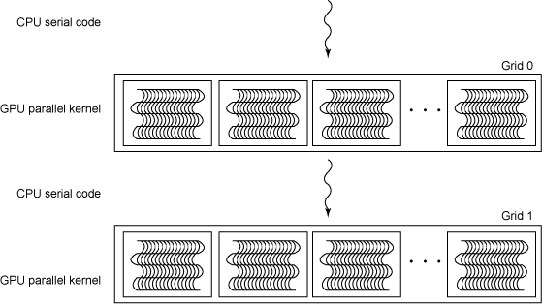
2.17 R-Tree in GPU: Spatial Query Processing
1
Containment query:
Find all the spatial objects within a user defined query region.
Query Region 1
2
3
Query Region 2
4
6
Query Region 3
5
7
10
8
9
11
Query Region 1
2
3
6
Query Region 2
4
Query Region 3
10
7
Time = 0
Time = 1
Query Regions
Block of threads
Result
Containment Query processing in GPU
Notes:
Let us observe how containment query is processed in gpus.
In the figures the dotted rectangles shows the user defined query regions.
Since the computation of one query region is not related to other. So, each query region can be processed in parallel using GPU thread blocks.
Irrelevant objects are pruned using the GPU based R-tree.
The result spatial objects that are contained within the respective query region.
So, this is how spatial query processing is executed in GPU. In the next slide we will compare all the SBD system based on different criteria.

Slide 24
Comparison on Different Systems
 | Hadoop-GIS | SpatialHadoop | GeoSpark | GPU R-Tree | SciDB
Spatial Data
Type
Objects
Objects
Objects
Objects
Raster
Spatial
Query
Object relationship
Object relationship
Object relationship
Object relationship
Map algebra
(Non-Extensible)
(Extensible)
(Non-Extensible)
(Non-Extensible)
(Extensible)
Spatial Index
Creation
Strategy
Parallel: MapReduce
Parallel: GPU threads
Sequential
Sequential
Sequential
Query
Parallelization
Technique
Distributed Query Processing
MapReduce
MapReduce
MapReduce
Parallel: GPU threads
Comparison of SBD Processing System
Observations:
- Raster data is only supported by SciDB
- SpatialHadoop and SciDB are extensible
- Index creation strategy is faster in SpatialHadoop and GPU in R-Tree
Notes:
In this slide we are going to compare the SBD systems based on spatial data type support, spatial query support, spatial index creating strategy, and query parallelizing techniques.
Most of the core paper we discussed today supported object based spatial data type such as point line and polygon, Scidb is the only SBD system that supports raster data.
likewise most of the core paper system supported object relationship type spatial query such as containment, overlap, and so on. Where as scidb provided map algebra based spatial query support such focal neighborhood operation in raster data.
Also SpatialHadoop and SciDB are extensible in a sense that it can be extended with user define functions. But the other systems does not provide extensibility.
The index generation strategy is parallel in case of spatialhadoop and gpu r-tree whereas in case of rest of the system index creation is done in sequential manner.
Finally, all the systems provides parallel spatial query processing.
In the next slide we are going to compare the SBD system based on different performance criteria.

Slide 25
Comparison on Different Systems
 | Hadoop-GIS | SpatialHadoop | GeoSpark | GPU R-Tree | SciDB
Data Size Support
Real-time Processing
Iterative task support
High
High
High
Low
High
Low
Low
Moderate
High
Low
Low
Low
Moderate
High
Low
Comparison based on performance criteria
Appropriate SBD system can be selected on the basis of:
Spatial data type requirement
Computation scenario
Data size
Notes:
In this slide we are going to compare the SBD system based on performance criteria such as data size support, real-time processing and iterative task support.
The distributed system based SBD system provided high data size support because they are highly scalable and new storage or processing nodes can be easily added on them. But GPU has low data size support because of its fixed maximum memory limit that cannot be easily extended.
But In case of real-time processing support GPU provides high support because of its consist of thousands of processing cores and high memory bandwidth suitable for real-time processing. Geospark utilizes in memory processing of the data and provide a moderate support for real-time processing in comparision to the rest of the system which impements disk based processing and shows low support for real time processing.
Finally, GPU are designed for supporting high iterative task and Geospark shows moderate support and the rest of the system including Hadoop based system and Scidb shows low iterative task support.
From above comparisons , we can select the appropriate SBD system based on the spatial data type requirement, computational scenario and size of the spatial data.
Note:
Memory bandwidth is the rate at which data can be read from or stored into a semiconductor memory by a processor.

Slide 26
A Demo of Spatial Big Data Platform: Google Earth Engine

Slide 27
Outline
Spatial Big Data Computation
Examples of Spatial Big Data Processing Systems
Conclusion
Notes:
Now that we have analyzed the core papers and discussed how conventional solution for spatial query is scaled for the big data platform.
In this section we will discuss some of the open research question in the area of spatial big data computing.

Slide 28
Reference
Hadoop-GIS: A High Performance Spatial Data Warehousing System over MapReduce Ablimit Aji, Fusheng Wang, Hoang Vo, Rubao Lee, Qiaoling Liu, Xiaodong Zhang, Joel Saltz Proceedings of the VLDB Endowment, VOl.6, No. 11
SpatialHadoop: A MapReduce Framework for Spatial Data Ahmed Eldawy, Mohomed F. Mokbel Proceedings of the IEEE International Conference on Data Engineering (ICDE '15). IEEE, 2015
GeoSpark: A Cluster Computing Framework for Processing Large-Scale Spatial Data Jia Yu, Jinxuan Wu, Mohamed Sarwat Proceedings of the 2015 International Conference on Advances in Geographic Information Systems, ACM SIGSPATIAL 2015 (2015)
Overview of SciDB: large scale array storage, processing and analysis. Brown, Paul G. Proceedings of the 2010 ACM SIGMOD International Conference on Management of data. ACM, 2010.
Parallel implementation of R-trees on the GPU. Luo, Lijuan, Martin DF Wong, and Lance Leong. 17th Asia and South Pacific Design Automation Conference. IEEE, 2012.

